Slide 1

NETWORK PROTOCOLS & SECURITY 23EC2210R/A/E Credits: 4/6/6
Course Coordinator: A. Prasanna Lakshmi

Slide 2
Syllabus
CO1:
Introduction to Computer networks and Data Link Layer: Introduction to Computer networks Use of Computer Networks, Network Hardware, Network software, Reference models: OSI and TCP/IP, Example Networks, Physical Layer: The theoretical basis for Data Communication, Guided and Unguided Transmission Media, Switching, Modems, ADSL, Trunks AND Multiplexing. Data Link Layer: DLL design issues. Error Detection and Correction, Elementary data link protocols, sliding window protocols. Medium Access Control Sub layer: Channel allocation problem, multiple access protocols, Ethernet.
CO 2:
Inter-networking Devices: Preamble to Network Layer, Distinguishing of Networking Devices and Inter-networking Devices, Analysis of Router Processing: Access, core and distribution. VLANS, Ethernet Inter-networking Technologies: Wired Router, Wireless Router, Gateway, CSU/DSU; Addressing: IP addressing (IPV4 & IPV6), subnetting; Types of Routing: static, default and dynamic. Networking Protocols: RIP, OSPF, BGP; Access Control list for IPV4, IPV6, Other Protocols: NAT, ARP, Port Address Translation (PAT), IP Tunneling; DHCP

Slide 3
CO 3: Transport Layer:
Process to Process Delivery; UDP; TCP; FCP Fiber Channel Protocol; Stream Control Transmission Protocol (SCTP); Congestion Control: Open Loop, Closed Loop Choke Packets; Quality of Service: Techniques to ImproveQoS: Leaky bucket algorithm, Token bucket algorithm. Session Layer: ISNS Internet Storage Name Service. Presentation Layer: SSL , preface of Socket , Secure Socket Layer Application Layer: Telnet, TFTP, POP3, DNS, SMTP, SNMP, FTP, NTP, SSDP.
CO 4:
Introduction to Security, Security goals, Security Attacks, Security Services and Mechanisms, A Security Model, Asymmetric & Symmetric key Ciphers, Substitution Techniques, Transposition Techniques, DES, RSA algorithm. Network Security: Essential Steps for Configuring a New Server and firewalls, Digital signatures.
CO 5:
HDLC,PPP, PPoE, AAA, IPsec, Generic Routing algorithm, IPv6 and routing, MPLS and SR Routing, Link Aggregation, OSPF:Router ID, DR, BDR and their election, loopback address and its use, OSPFv1 to OSPFv3, Wild card mask, Application Services DHCPv6.

Slide 4
CO1: Introduction to Computer networks and Data Link Layer:
Introduction to Computer networks :Use of Computer Networks, Network Hardware, Network software
Reference models: OSI and TCP/IP, Example Networks
Physical Layer: Theoretical basis for Data Communication, Guided and Unguided Transmission Media, Switching, Modems, ADSL, Trunks and Multiplexing.
Data Link Layer: DLL design issues. Error Detection and Correction, Elementary data link protocols, sliding window protocols. Medium Access Control Sub layer: Channel allocation problem, multiple access protocols, Ethernet.

Slide 5
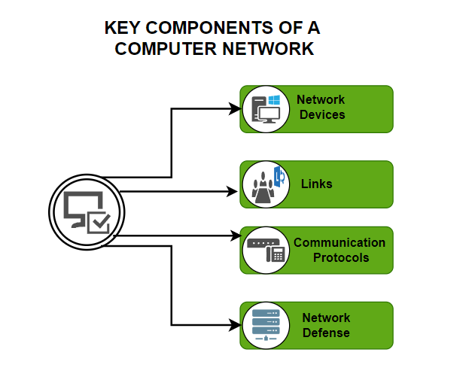

Slide 6
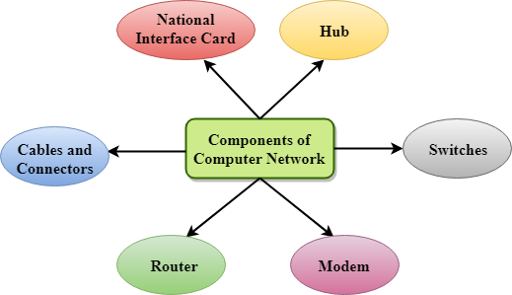
Introduction to Computer networks
Computer Network is a group of computers connected with each other through wires, optical fibres or optical links so that various devices can interact with each other through a network.

Slide 7
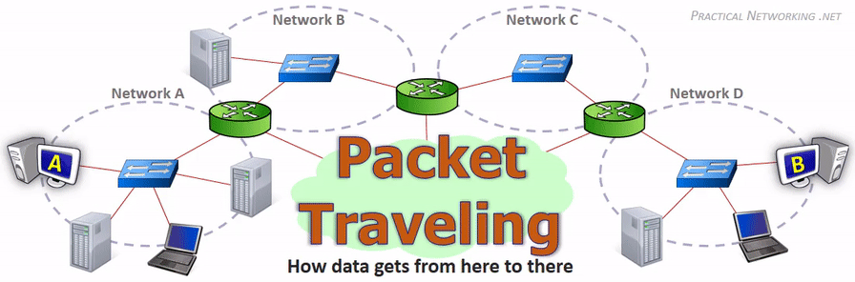

Slide 8
Uses Of Computer Network
Communicating using email, video, instant messaging, etc.
Sharing devices such as printers, scanners, etc.
Sharing files
Sharing software and operating programs on remote systems
Allowing network users to easily access and maintain information

Slide 9
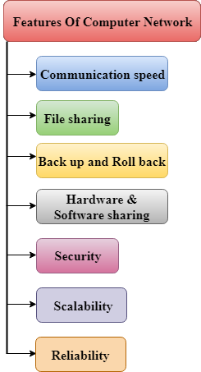
Features Of Computer network

Slide 10
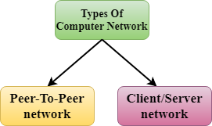
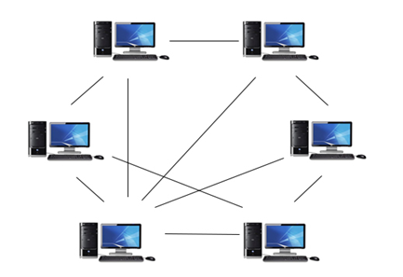
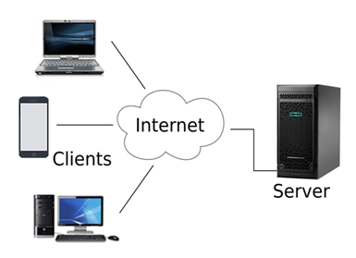
Computer Network Architecture

Slide 11
Difference between Client-Server and Peer-to-Peer Network:
S.NO | Client-Server Network | Peer-to-Peer Network
1. | In Client-Server Network, Clients and server are differentiated, Specific server and clients are present. | In Peer-to-Peer Network, Clients and server are not differentiated.
2. | Client-Server Network focuses on information sharing. | While Peer-to-Peer Network focuses on connectivity.
3. | In Client-Server Network, Centralized server is used to store the data. | While in Peer-to-Peer Network, Each peer has its own data.
4. | In Client-Server Network, Server respond the services which is request by Client. | While in Peer-to-Peer Network, Each and every node can do both request and respond for the services.
5. | Client-Server Network are costlier than Peer-to-Peer Network. | While Peer-to-Peer Network are less costlier than Client-Server Network.
6. | Client-Server Network are more stable than Peer-to-Peer Network. | While Peer-to-Peer Network are less stable if number of peer is increase.
7. | Client-Server Network is used for both small and large networks. | While Peer-to-Peer Network is generally suited for small networks with fewer than 10 computers.

Slide 12
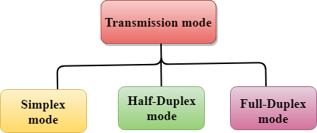


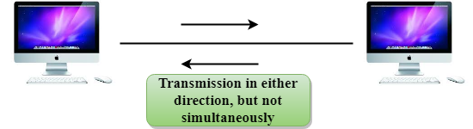
Transmission modes

Slide 13
Differences b/w Simplex, Half-duplex and Full-duplex mode
Basis for comparison | Simplex mode | Half-duplex mode | Full-duplex mode
Direction of communication | In simplex mode, the communication is unidirectional. | In half-duplex mode, the communication is bidirectional, but one at a time. | In full-duplex mode, the communication is bidirectional.
Send/Receive | A device can only send the data but cannot receive it or it can only receive the data but cannot send it. | Both the devices can send and receive the data, but one at a time. | Both the devices can send and receive the data simultaneously.
Performance | The performance of half-duplex mode is better than the simplex mode. | The performance of full-duplex mode is better than the half-duplex mode. | The Full-duplex mode has better performance among simplex and half-duplex mode as it doubles the utilization of the capacity of the communication channel.
Example | Examples of Simplex mode are radio, keyboard, and monitor. | Example of half-duplex is Walkie-Talkies. | Example of the Full-duplex mode is a telephone network.

Slide 14
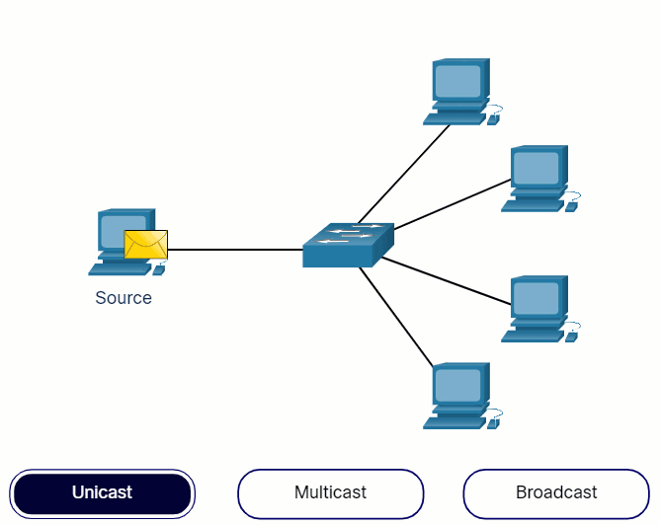
Types of Communications

Slide 15
Types of Networks
Division based on area covered
Based on types of communication
Based on the type of architecture
Division based on the communication medium
Based on protocols
Network Topology
Networking Devices

Slide 16
Network Hardware (Based on Ranges)
Local Area Network (LAN)
Metropolitan Area Network (MAN)
Wide Area Network (WAN)
Personal Area Network (PAN)
Wireless Local Area Network (WLAN)
Campus Area Network (CAN)
Storage Area Network (SAN)
System-Area Network (SAN)
Passive Optical Local Area Network (POLAN)
Enterprise Private Network (EPN)
Virtual Private Network (VPN)
Home Area Network (HAN)

Slide 17
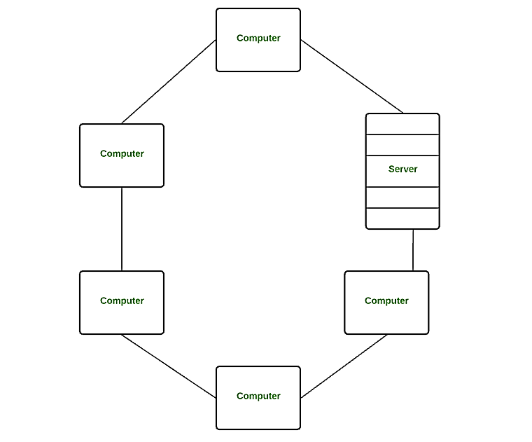
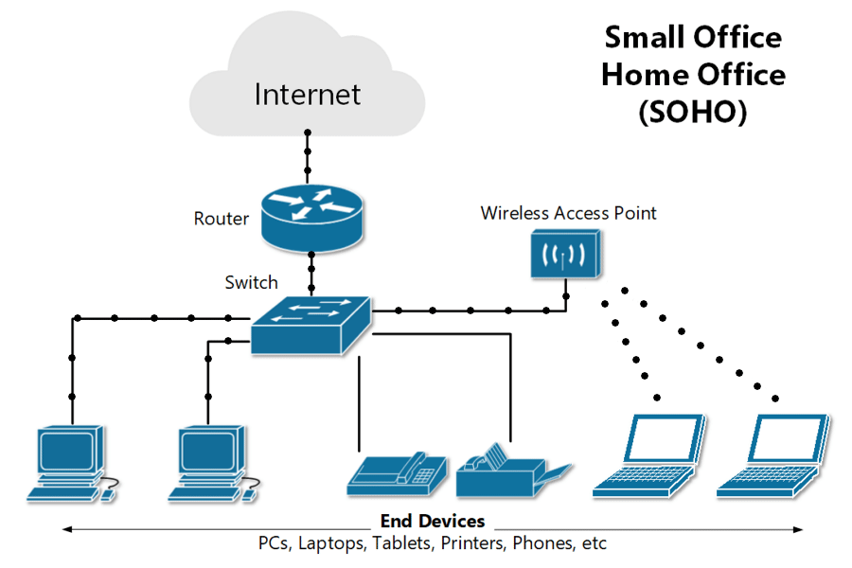
Local Area Network (LAN)

Slide 18
Local Area Network (LAN) (few points)
Local Area Network is a group of computers connected to each other in a small area such as building, office.
LAN is used for connecting two or more personal computers through a communication medium such as twisted pair, coaxial cable, etc.
It is less costly as it is built with inexpensive hardware such as hubs, network adapters, and ethernet cables.
The data is transferred at an extremely faster rate in Local Area Network.
Local Area Network provides higher security.
Disadvantage:
Lack of Privacy

Slide 19
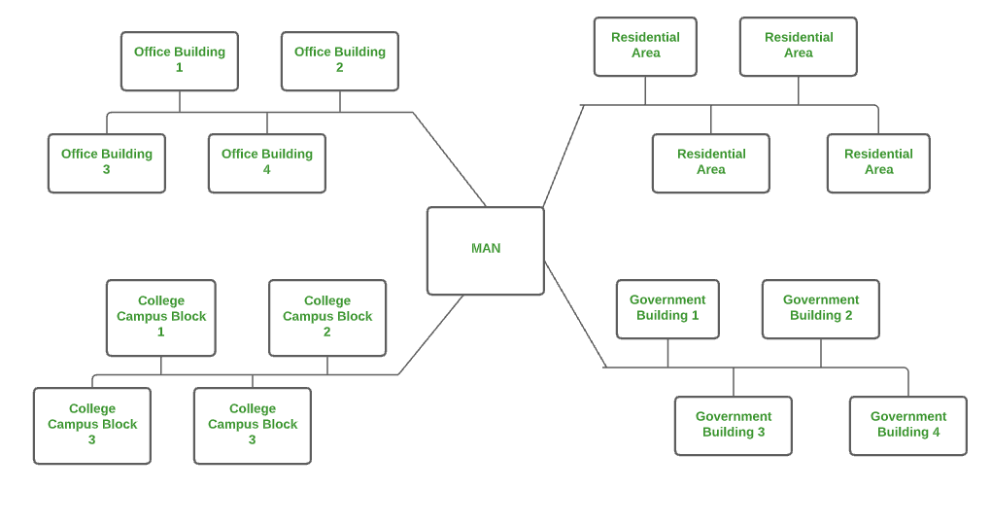
Metropolitan Area Network (MAN)

Slide 20
A metropolitan area network is a network that covers a larger geographic area by interconnecting a different LAN to form a larger network.
Government agencies use MAN to connect to the citizens and private industries.
In MAN, various LANs are connected to each other through a telephone exchange line, fiber Cables.
The most widely used protocols in MAN are RS-232, Frame Relay, ATM, ISDN, OC-3, ADSL, etc.
It has a higher range than Local Area Network(LAN).
Less Security.
Uses Of Metropolitan Area Network:
MAN is used in communication between the banks in a city.
It can be used in an Airline Reservation.
It can be used in a college within a city.
It can also be used for communication in the military.

Slide 21
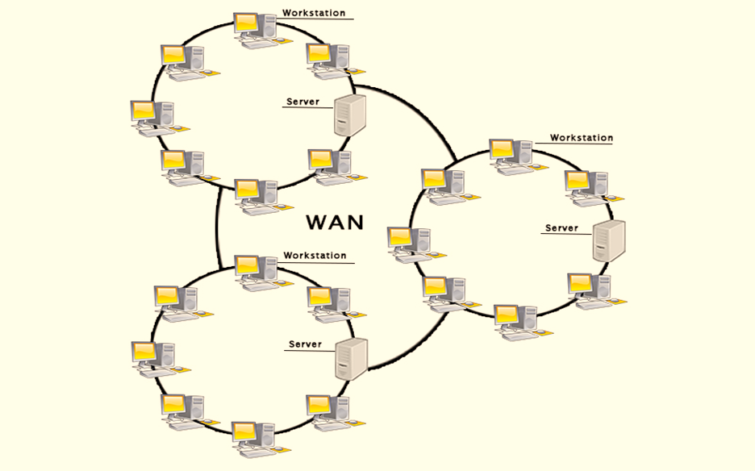
Wide Area Network (WAN)
A Wide Area Network is a network that extends over a large geographical area such as states or countries.
A Wide Area Network is quite bigger network than the LAN.
A Wide Area Network is not limited to a single location, but it spans over a large geographical area through a telephone line, fiber optic cable or satellite links.
The internet is one of the biggest WAN in the world.
A Wide Area Network is widely used in the field of Business, government, and education.
Less Security.

Slide 22
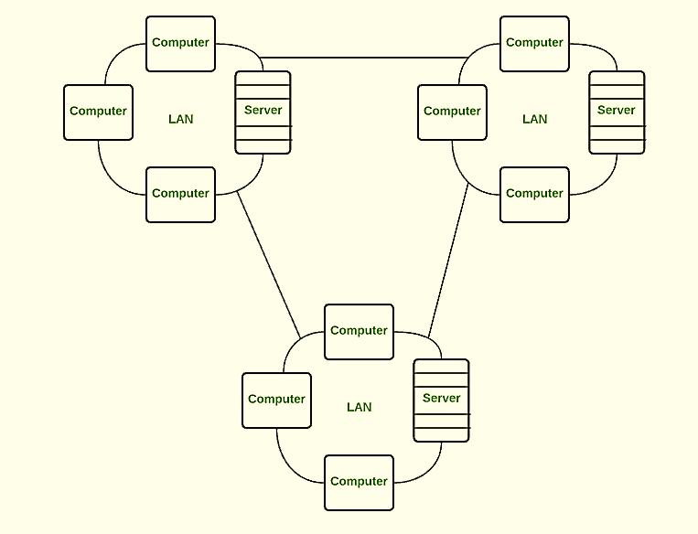
Examples Of Wide Area Network:
Mobile Broadband: A 4G network is widely used across a region or country.
Last mile: A telecom company is used to provide the internet services to the customers in hundreds of cities by connecting their home with fiber.
Private network: A bank provides a private network that connects the 44 offices. This network is made by using the telephone leased line provided by the telecom company.

Slide 23
Advantages Of Wide Area Network:
Following are the advantages of the Wide Area Network:
Geographical area: A Wide Area Network provides a large geographical area. Suppose if the branch of our office is in a different city then we can connect with them through WAN. The internet provides a leased line through which we can connect with another branch.
Centralized data: In case of WAN network, data is centralized. Therefore, we do not need to buy the emails, files or back up servers.
Get updated files: Software companies work on the live server. Therefore, the programmers get the updated files within seconds.
Exchange messages: In a WAN network, messages are transmitted fast. The web application like Facebook, Whatsapp, Skype allows you to communicate with friends.
Sharing of software and resources: In WAN network, we can share the software and other resources like a hard drive, RAM.
Global business: We can do the business over the internet globally.
High bandwidth: If we use the leased lines for our company then this gives the high bandwidth. The high bandwidth increases the data transfer rate which in turn increases the productivity of our company.

Slide 24
Disadvantages of Wide Area Network:
The following are the disadvantages of the Wide Area Network:
Security issue: A WAN network has more security issues as compared to LAN and MAN network as all the technologies are combined together that creates the security problem.
Needs Firewall & antivirus software: The data is transferred on the internet which can be changed or hacked by the hackers, so the firewall needs to be used. Some people can inject the virus in our system so antivirus is needed to protect from such a virus.
High Setup cost: An installation cost of the WAN network is high as it involves the purchasing of routers, switches.
Troubleshooting problems: It covers a large area so fixing the problem is difficult.

Slide 25
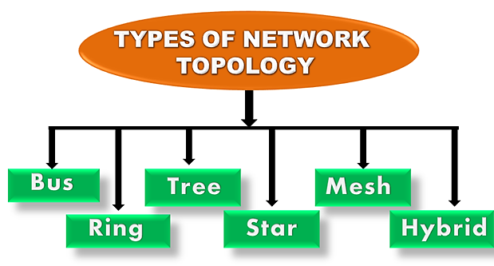
NETWORK TOPOLOGIES
The arrangement of a network that comprises nodes and connecting lines via sender and receiver is referred to as network topology. The various network topologies are:

Slide 26
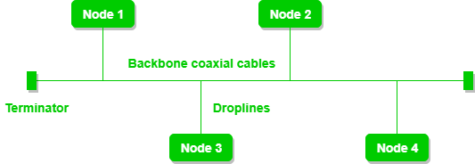
Bus Topology:
Problems with this topology: A bus topology is quite simpler, but still, it requires a lot of cabling.
If the common cable fails, then the whole system will crash down.
If the network traffic is heavy, it increases collisions in the network. To avoid this, various protocols are used in the MAC layer known as Pure Aloha, Slotted Aloha, CSMA/CD, etc.
Adding new devices to the network would slow down networks.
Security is very low.
Advantages of this topology:
If N devices are connected to each other in a bus topology, then the number of cables required to connect them is 1, known as backbone cable, and N drop lines are required.
Coaxial or twisted pair cables are mainly used in bus-based networks that support up to 10 Mbps.
The cost of the cable is less compared to other topologies, but it is used to build small networks.
Bus topology is familiar technology as installation and troubleshooting techniques are well known.

Slide 27
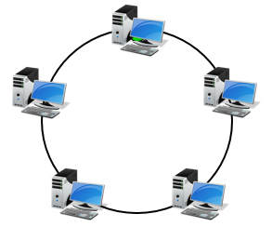
Ring Topology:
Advantages:
Very orderly network where every device has access to the token and the opportunity to transmit.
Easier to manage than a Bus Network
Good Communication over long distances
Handles high volume of traffic
Disadvantages
The failure of a single node of the network can cause the entire network to fail.
The movement or changes made to network nodes affects the performance of the entire network.

Slide 28
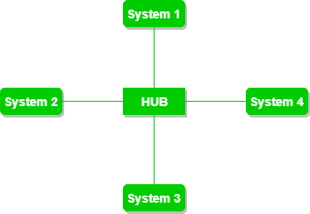
Star Topology
Advantages of this topology:
If N devices are connected to each other in a star topology, then the number of cables required to connect them is N. So, it is easy to set up.
Each device requires only 1 port i.e. to connect to the hub, therefore the total number of ports required is N.
It is Robust. If one link fails only that link will affect and not other than that.
Easy to fault identification and fault isolation.
Star topology is cost-effective as it uses inexpensive coaxial cable.
Performance is based on the single concentrator i.e. hub.
Problems with this topology:
If the concentrator (hub) on which the whole topology relies fails, the whole system will crash down.
The cost of installation is high.

Slide 29
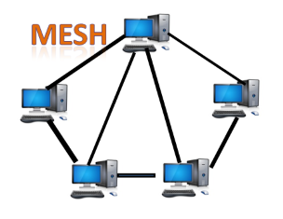
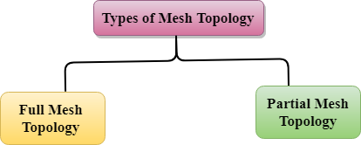
Mesh Topology
Disadvantages of Mesh topology
Cost: A mesh topology contains a large number of connected devices such as a router and more transmission media than other topologies.
Management: Mesh topology networks are very large and very difficult to maintain and manage. If the network is not monitored carefully, then the communication link failure goes undetected.
Efficiency: In this topology, redundant connections are high that reduces the efficiency of the network.
Advantages of Mesh topology:
Reliable: The mesh topology networks are very reliable as if any link breakdown will not affect the communication between connected computers.
Fast Communication: Communication is very fast between the nodes.
Easier Reconfiguration: Adding new devices would not disrupt the communication between other devices.

Slide 30
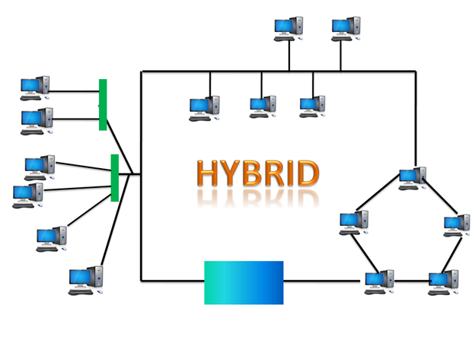
Hybrid Topology

Slide 31
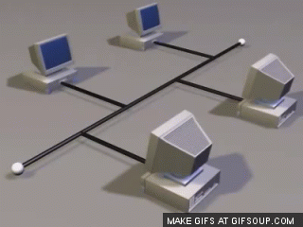
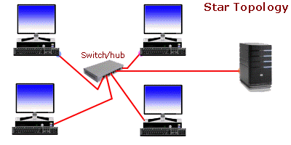
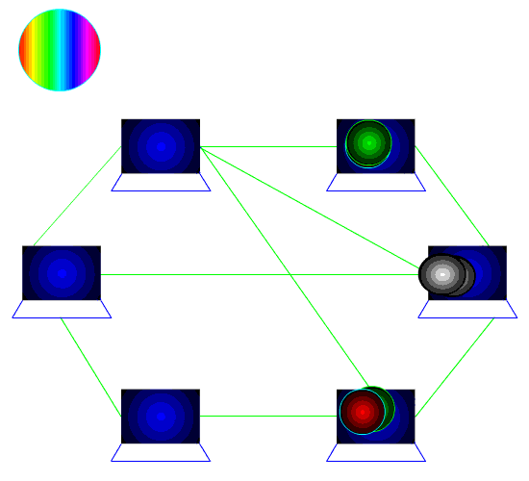
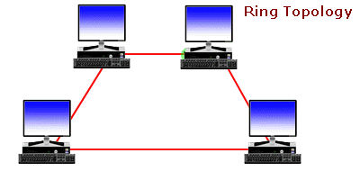

Slide 32
Open System Interconnection
OSI stands for Open System Interconnection is a reference model that describes how information from a software application in one computer moves through a physical medium to the software application in another computer.
OSI consists of seven layers, and each layer performs a particular network function.
OSI model was developed by the International Organization for Standardization (ISO) in 1984, and it is now considered as an architectural model for the inter-computer communications.
OSI model divides the whole task into seven smaller and manageable tasks. Each layer is assigned a particular task.
Each layer is self-contained, so that task assigned to each layer can be performed independently.

Slide 33
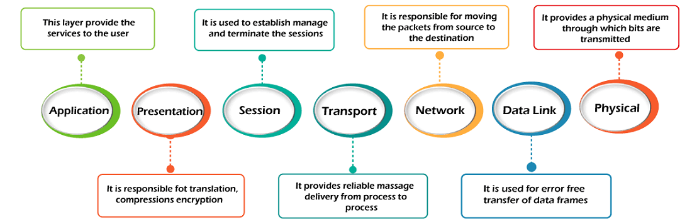
OSI Seven Layers

Slide 34
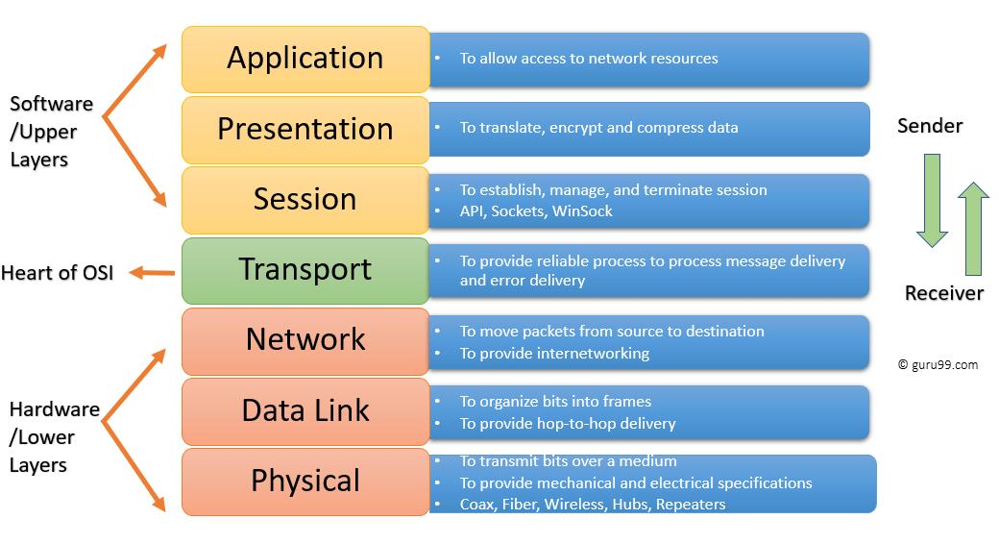
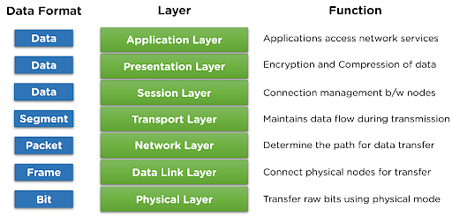
Functions of OSI layers

Slide 35
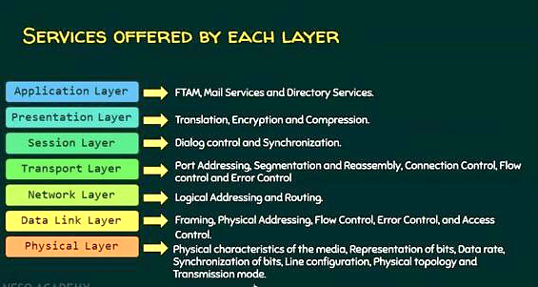

Slide 36
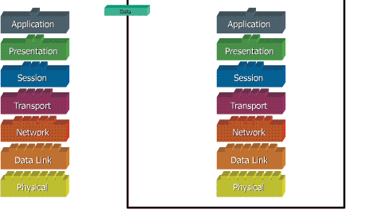

Slide 37
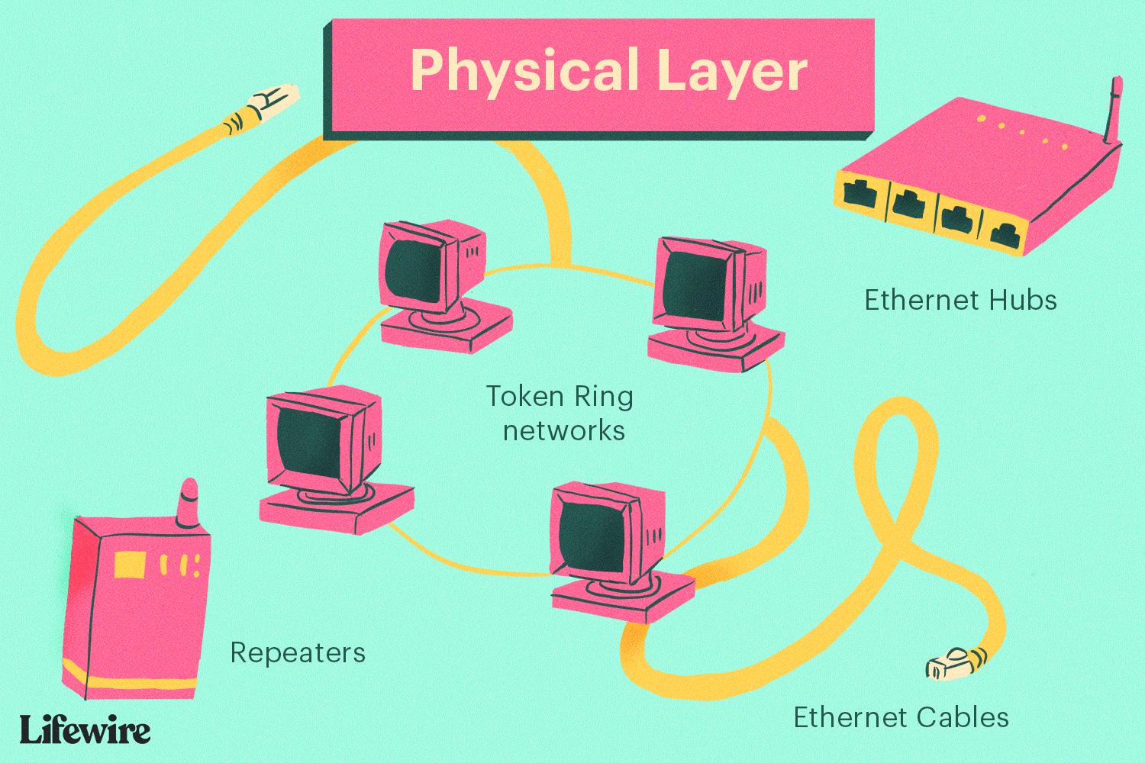

Slide 38
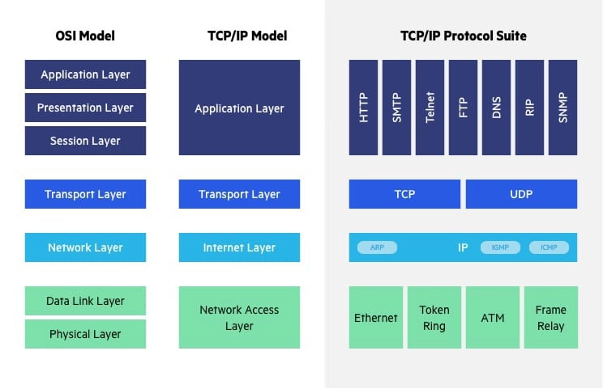
TCP/IP Model

Slide 39
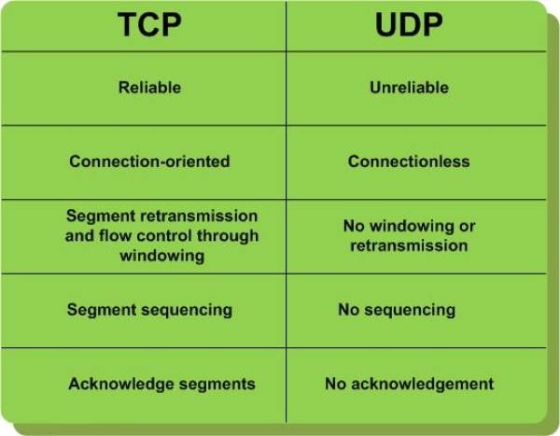
TCP & UDP

Slide 40
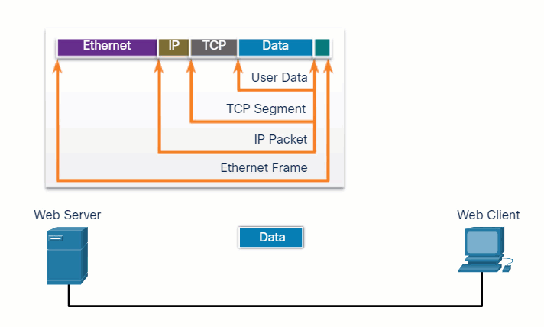

Slide 41
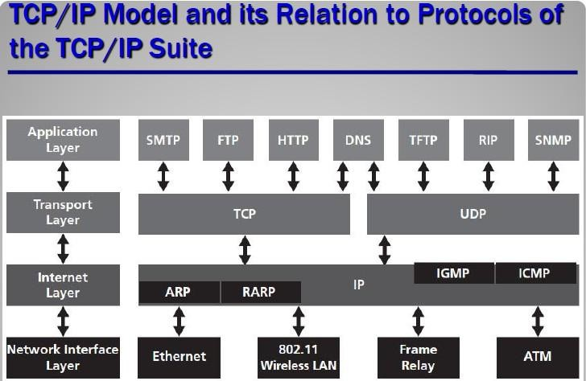
Tcp/ip model AND RELATION TO PROTOCOLS OF TCP/IP SUITE

Slide 42
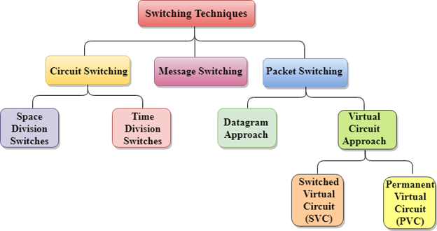

Slide 43
Circuit Switching
Circuit switching is a switching technique that establishes a dedicated path between sender and receiver.
Once the connection is established then the dedicated path will remain to exist until the connection is terminated.
Circuit switching in a network operates in a similar way as the public telephone networks.
when any user wants to send the data, voice, video, a request signal is sent to the receiver then the receiver sends back the acknowledgment to ensure the availability of the dedicated path.
After receiving the acknowledgment, dedicated path transfers the data.
It is used for voice transmission.
Fixed data can be transferred at a time in circuit switching technology.

Slide 44
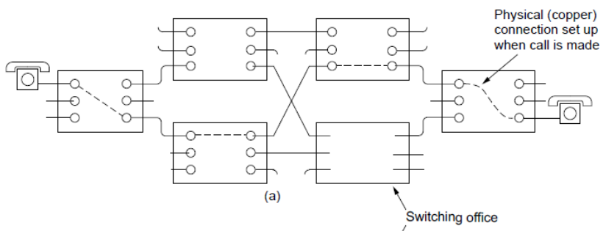
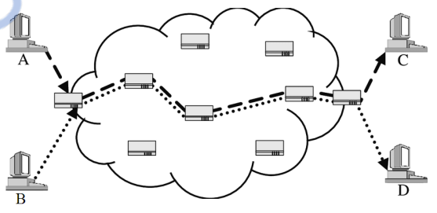

Slide 45
MESSAGE SWITCHING
Message Switching is a switching technique in which a message is transferred as a complete unit and routed through intermediate nodes at which it is stored and forwarded.
In Message Switching technique, there is no establishment of a dedicated path between the sender and receiver.
The destination address is appended to the message. Message Switching provides a dynamic routing as the message is routed through the intermediate nodes based on the information available in the message.
Message switches are programmed in such a way so that they can provide the most efficient routes. o Each and every node stores the entire message and then forward it to the next node. This type of network is known as store and forward network.
Message switching treats each message as an independent entity.

Slide 46
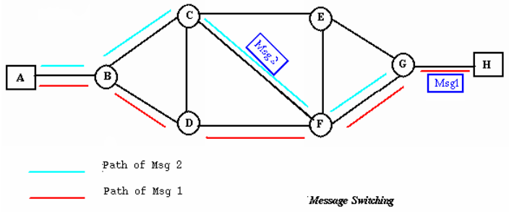
MESSAGE SWITCHING

Slide 47
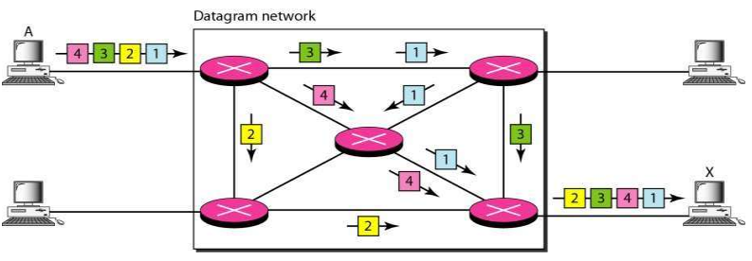
In this example, all four packets (or datagrams) belong to the same message, but may travel different paths to reach their destination.

